Slide 1
Digital to Voice Escalations and Transfers

Slide 2
How can you escalate a digital conversation to voice
Digital to Voice: Patient is trying to describe their symptoms over chat but is having trouble conveying the severity or complexity of their situation, the agent could offer to switch to voice to get a better understanding of the situation and provide more personalized care.
Transferring to a Department with Voice Lines: A customer is interested in purchasing a product that requires a custom installation. While the sales department can answer general product questions, the installation process requires technical expertise that is only available via phone. By escalating the chat to a voice call with the technical support department, the customer can get the information they need to make an informed purchase, and the sales agent can ensure a seamless customer experience.

Slide 3
WHY?
Sometimes it's easier to explain complex issues or convey emotions over voice rather than text.
You might feel like the chat isn't making progress and switching to voice could help move things forward.
If you're having trouble typing quickly, voice could be a more efficient way to communicate.
You might prefer voice as a form of communication in general and want to switch to it even if the chat is going well.
Escalating to voice could help build a stronger connection with the agent and improve the overall customer experience.
May need to transfer to a department where digital is not used

Slide 4
Watch the video and read the content for Basic Authorization:
https://github.com/CiscoDevNet/webex-contact-center-api-samples/tree/main/app-auth-sample
Review CREATE TASK API
https://developer.webex-cx.com/documentation/tasks/v1/create-task
Test Manually Creating your tasks
EXECUTE_FLOW – Execute an Entry Point to route to a specific routing script
OUTDIAL – Execute an Outdial flow to send the call to a specific OUTDIAL queue.
Set up token key management in WxConnect
Set up your Triggers under your Portal / Digital Channels
Create your webhooks to pass data from agent desktop to your WxConnect routing script
Create your flow builder routing scripts.

Slide 5
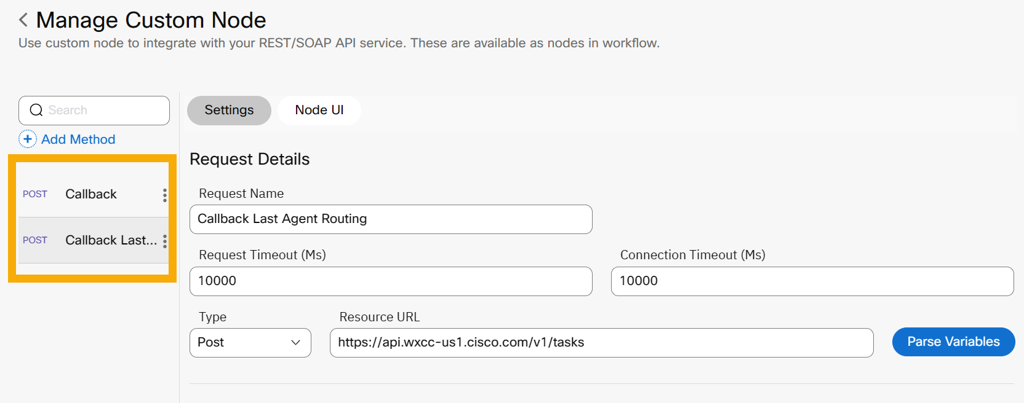
Webex Connect Custom Node Integration

Slide 6
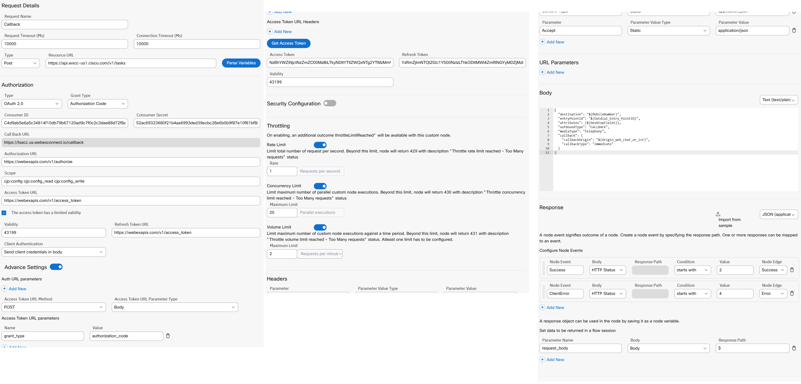
Webex Connect Custom Node Integration – Digital Escalation

Slide 7
Webex Connect Custom Node Integration – Digital Escalation
Resource: https://api.wxcc-us1.cisco.com/v1/tasks
Authorization: https://webexapis.com/v1/authorize
Scope: cjp:config cjp:config_read cjp:config_write
Access Token: https://webexapis.com/v1/access_token
Validity: 43199
Refresh Token: https://webexapis.com/v1/access_token
Access Toke URL Parameters: Name: grant_type Value: authorization_code
Body:
{ "destination": "$(MobileNumber)",
"entryPointId": "$(Outdial_Entry_PointID)",
"attributes": {"AgentLoginID":"$(AgentLoginID)","OrginalChannel":"$(OrginalChannel)",$(DesktopFields)},
"outboundType": "EXECUTE_FLOW",
"mediaType": "telephony“
}

Slide 8
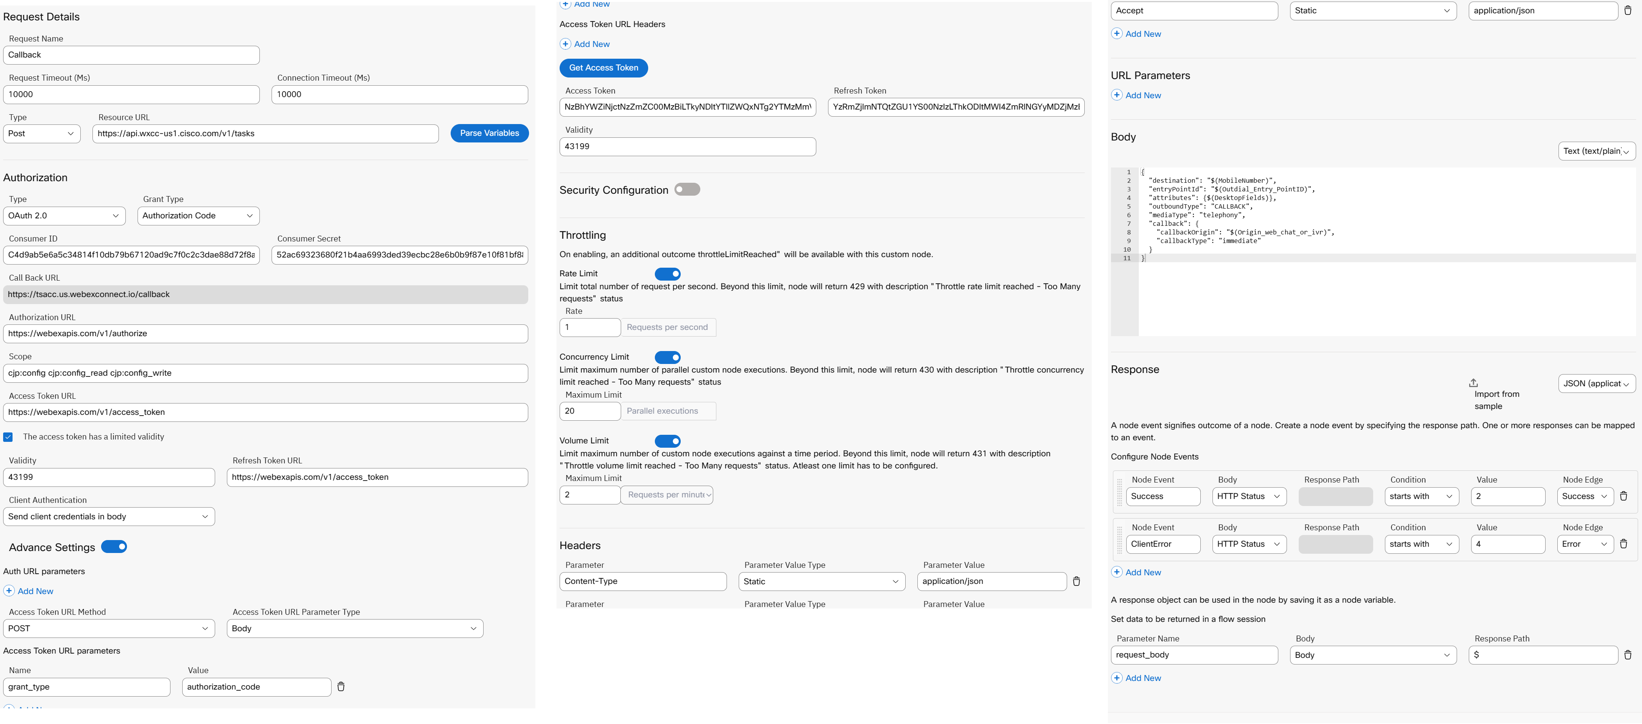
Webex Connect Custom Node Integration – Digital To Voice

Slide 9
Webex Connect Custom Node Integration – Digital To Voice
Resource: https://api.wxcc-us1.cisco.com/v1/tasks
Authorization: https://webexapis.com/v1/authorize
Scope: cjp:config cjp:config_read cjp:config_write
Access Token: https://webexapis.com/v1/access_token
Validity: 43199
Refresh Token: https://webexapis.com/v1/access_token
Access Toke URL Parameters: Name: grant_type Value: authorization_code
Body:
{
"destination": "$(MobileNumber)",
"entryPointId": "$(Outdial_Entry_PointID)",
"attributes": {$(DesktopFields)},
"outboundType": "CALLBACK",
"mediaType": "telephony",
"callback": {
"callbackOrigin": "$(Origin_web_chat_or_ivr)",
"callbackType": "immediate"
}
}

Slide 10
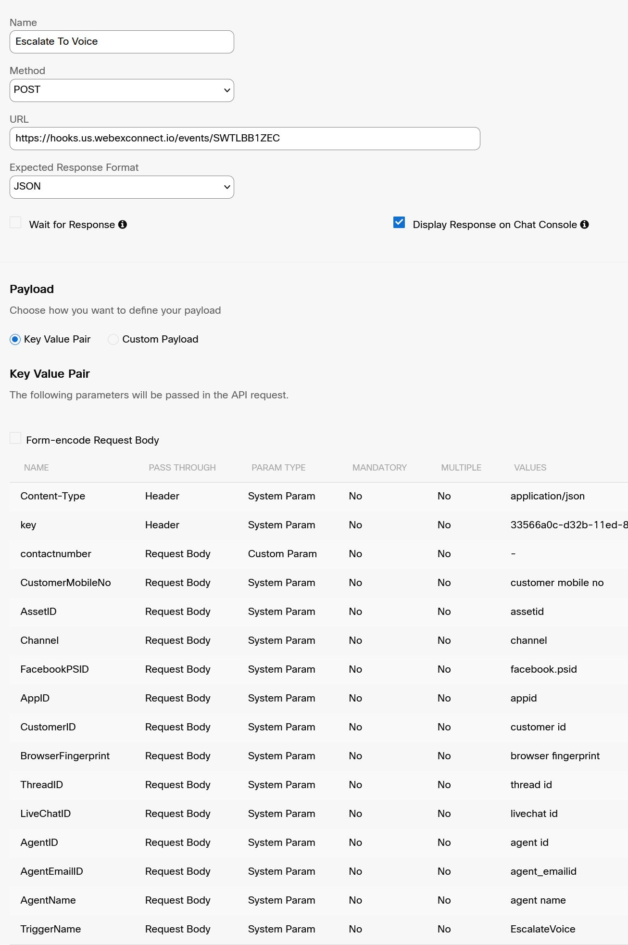
Webex Connect Flow - Digital Escalation
Portal -> New Digital Channels Cross Launch
Groups ->
Default ->
Default ->
Events and Rules ->
Add New Event
{
"contactnumber": "Number To Call Back On",
"CustomerMobileNo": "12263762555 - cell number",
"AssetID": "Asset defined in Connect, i.e SMS From Number ",
"Channel": "Facebook, SMS, LiveChat, WhatsApp, Email",
"FacebookPSID": "Facebook PageID",
"AppID": "Livechat appID",
"CustomerID": "Livechat CustomerID",
"BrowserFingerprint": "Livechat BrowserID",
"ThreadID": "Livechat Thread",
"LiveChatID": "Livechat ID",
"AgentID": "Agent login ID",
"AgentEmailID": "Agent Email ID",
"AgentName": "Agents Name",
"TriggerName": "Name you called your trigger"
}

Slide 11
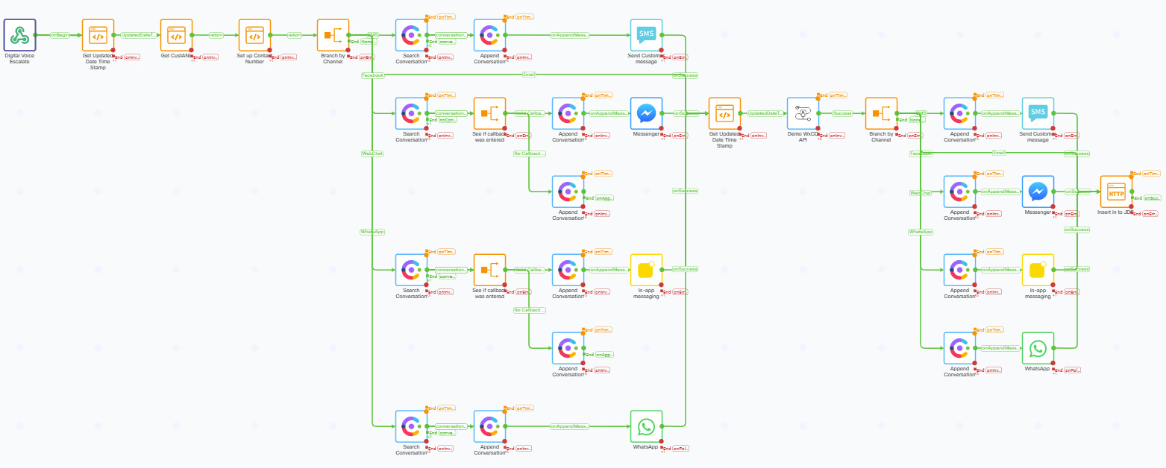
Webex Connect Flow – Digital Escalation

Slide 12
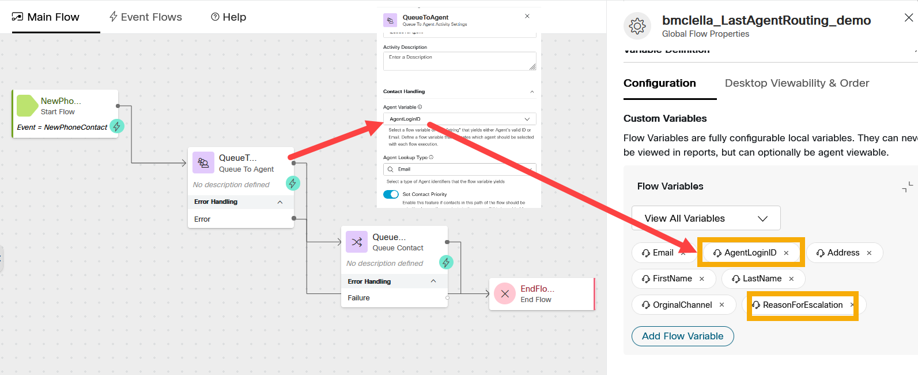
Webex Flow Builder – Digital Escalation

Slide 13
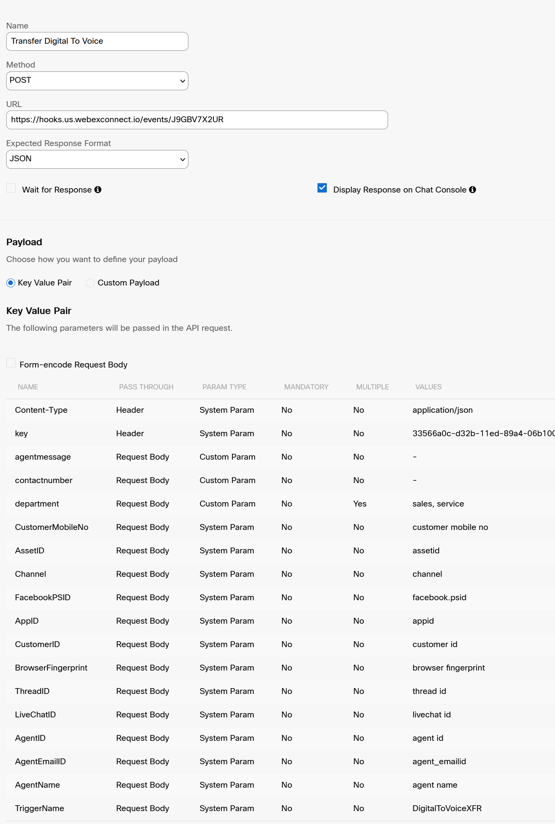
Digital To Voice Department
Portal -> New Digital Channels Cross Launch
Groups ->
Default ->
Default ->
Events and Rules ->
Add New Event
{
"agentmessage": "Message to send on transfer",
"contactnumber": "number to call back on",
"department": "sales or service",
"CustomerMobileNo": "12263762555 - cell number",
"AssetID": "Asset defined in Connect, i.e SMS From Number ",
"Channel": "Facebook, SMS, LiveChat, WhatsApp, Email, ",
"FacebookPSID": "Facebook PageID",
"AppID": "Livechat appID",
"CustomerID": "Livechat CustomerID",
"BrowserFingerprint": "Livechat BrowserID",
"ThreadID": "Livechat Thread",
"LiveChatID": "Livechat ID",
"AgentID": "Agent login ID",
"AgentEmailID": "Agent Email ID",
"AgentName": "Agents Name",
"TriggerName": "Name you called your trigger"
}

Slide 14

Webex Connect Flow – Digital To Voice

Slide 15
Custom Icons
"Callback": {
"name": "icon-icon-callback_16",
"color": "purple"
}
https://momentum.design/icons

Slide 16
Write notes to store in customers journey

Slide 17
Adding Notes to a customer journey
Adding notes and sentiment to a customer journey data storage can benefit sales by providing reps with a complete view of the customer journey, enabling personalized and empathetic service, and increasing the chances of customer retention. By accessing relevant information, sales reps can address issues and provide better experiences, ultimately driving sales and customer loyalty.

Slide 18
WHY?
Notes and sentiment provide a comprehensive record of each interaction with the customer
Improved customer experience
Better understanding of customer needs and preferences leads to more personalized and empathetic service
Identification of pain points
Reviewing customer journey data helps to identify areas where customers are having difficulty
Facilitation of customer retention
Understanding the customer journey enables proactive steps to address needs and ensure satisfaction

Slide 19
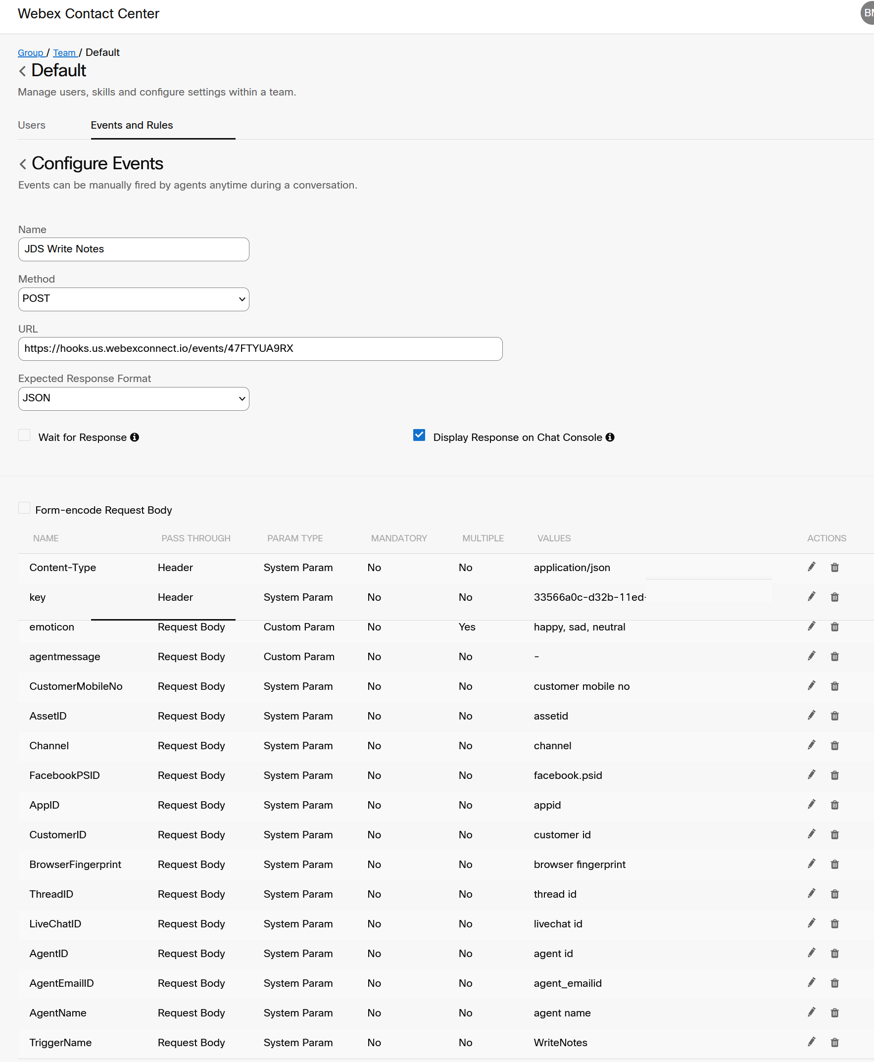
Setting up the trigger to execute the flow
Portal -> New Digital Channels Cross Launch
Groups ->
Default ->
Default ->
Events and Rules ->
Add New Event
{
"emoticon": "Happy or Sad or Neutral",
"agentmessage": "Agent Notes Comment",
"CustomerMobileNo": "12263762555 - cell number",
"AssetID": "Asset defined in Connect, i.e SMS From Number ",
"Channel": "Facebook, SMS, LiveChat, WhatsApp, Email, ",
"FacebookPSID": "Facebook PageID",
"AppID": "Livechat appID",
"CustomerID": "Livechat CustomerID",
"BrowserFingerprint": "Livechat BrowserID",
"ThreadID": "Livechat Thread",
"LiveChatID": "Livechat ID",
"AgentID": "Agent login ID",
"AgentEmailID": "Agent Email ID",
"AgentName": "Agents Name",
"TriggerName": "Name you called your trigger"
}

Slide 20
Custom Icons
"AgentNotesHappy": {
"name": "icon-emoticons_16",
"color": "cobalt"
},
"AgentNotesSad": {
"name": "icon-emoticon-sad_24",
"color": "red"
},
"AgentNotesNeutral": {
"name": "icon-emoticon-passive_24",
"color": "yellow"
}
https://momentum.design/icons

Slide 21
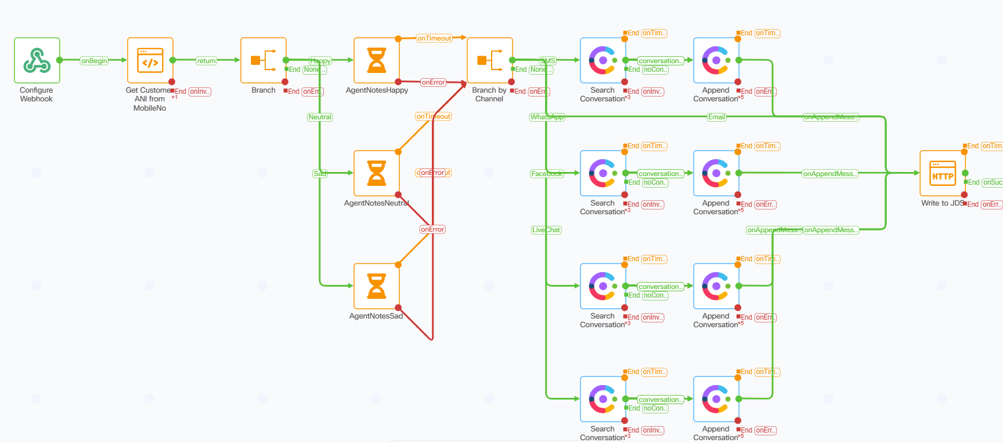
Webex Connect Flow

